Slide 1


Tractor Market Exchange
2024 Q2

Slide 2
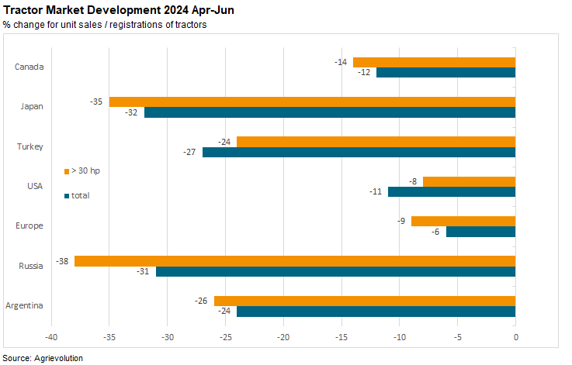

Slide 3
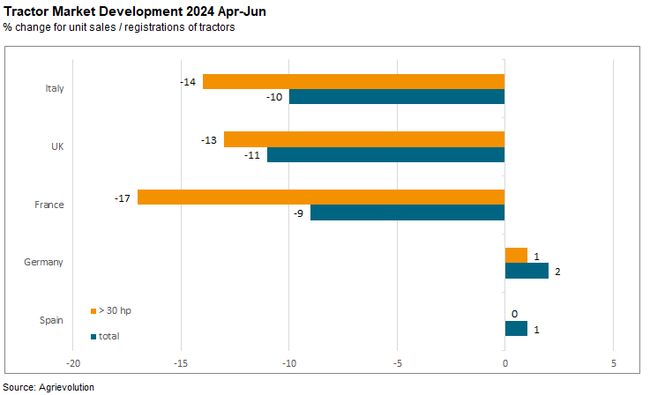

Slide 4
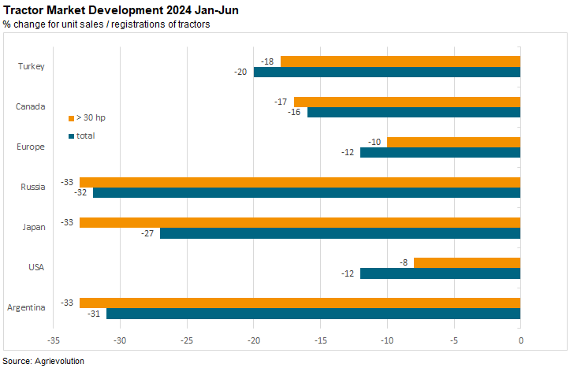

Slide 5
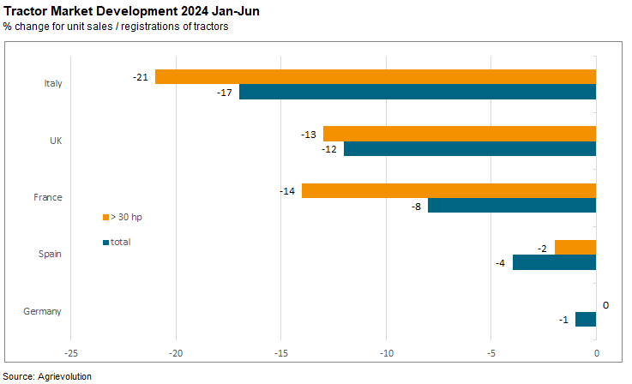

Slide 6

Dates for the Tractor Market Exchange
quarterly
next deadlines for sending the data to the secretariat:
  Q3 2024 by the 15th November 2024

